Slide 1

R Shiny for Building Web Applications
https://z.umn.edu/Rshiny
Sign-in:
Friday Oct 11, 9-12 AM
Skok Hall, Room 100
Instructors & helpers: Alex Bajcz, Jessica Barry, Cody Hennessy
z.umn.edu/swc-signin
Notes:
Hi all, welcome to the very first edition of our SWC-inspired workshop on using R Shiny to build web apps.
-I’m Alex Bajcz, lead designer for this workshop, and I’m joined by Jessica Barry and Cody Hennessy today.
-What I’ll cover is a stripped-down version of the full lesson I’ve drafted available at this URL.
-Before we start, please ensure you’ve signed in to this workshop at this site—can you raise your hands if you aren’t sure if you have done this yet?

Slide 2
Carpentries Code of Conduct
Use welcoming, inclusive language.
Be respectful of differing viewpoints and lived experiences.
Accept constructive criticism gracefully.
Focus on what’s best for learning.
Show everyone courtesy and respect.
https://z.umn.edu/ccoc
Notes:
Ok, as we begin, I want to briefly introduce the Carpentries Code of Conduct. These are the principles that’ll guide our instruction and learning.
-We are agreeing, by being here, to be welcoming, inclusive, respectful, and constructive. We will be courteous and focused on enhancing everyone’s learning.

Slide 3
Welcome
Intention: Cover web development basics and project setup (Hour 1), Shiny core concepts (Hour 2), and complex interactive elements (Hour 3).
…But we’ll get to what we get to! We’ll take 10-minute breaks at 9:50 and 10:50 and end at 12:00 no matter what.
With the exception of the first third, this’ll be a live-coding workshop—we’ll code together in real time!
Ask questions!!!
Raise your hand, put a post-it on your laptop, or wave down a helper.
Restrooms:
All-gender restrooms are just outside the classroom as well as in Skok B40, 237, and 241.
Notes:
Now, we have scheduled 3 hours for today’s workshop. Is that enough? Too much? I have no idea lol we’ll find out!
-However, the intention is to cover web development basics and setup in Hour 1, Shiny core concepts in Hour 2, and more complex but fun visual elements in Hour 3.
-That said, we will take 2 ten-minute breaks and end on time no matter what. We’ll get to what we get to!
-The first hour will be a bit of an exception to this, but this is a live-coding workshop. That is, we will be coding up here and we want you all coding right along side us every step of the way.
-As we go, please stop us and ask questions! Raise your hand, tack a sticky to your computer, flag down a helper—however you feel comfortable getting our attention.
-If you need restrooms, there are two just outside here. Feel free to use them at any time.

Slide 4
Introductions
Name
Preferred pronouns (if you’re comfortable sharing)
Affiliation
Icebreaker: All-time favorite Halloween costume
Notes:
I’d like us to very briefly do intros. In the interests of time, please keep it to your name, preferred pronouns, affiliation, and your favorite Halloween costume you’ve ever had/seen/heard of!

Slide 5
Installation / set-up
This course assumes you’ve downloaded and installed R and RStudio.
If you haven’t, raise your hand!
Please install the packages we’l use today now:
install.packages(c("shiny", "dplyr", "ggplot2", "leaflet",
"DT", "plotly", "gapminder", "sf"))
Navigate to the course’s online curriculum page: https://z.umn.edu/Rshiny
Previous R+RStudio experience is assumed—this workshop won’t cover any introductory R content!
However, no previous Shiny or web development experience is assumed—our goal is to take everyone from “web 0 to web hero!”
Notes:
-Nice to meet you all! Last bit of housekeeping—expectations and setup.
-First, we expect you’ve already downloaded and installed R and RStudio and that you’ll use RStudio throughout. Please flag us down now if you have concerns.
-Second, it’d be good to install the packages we’ll need—listed here. If you help installing them, please raise your hand.
-Third, full disclosure—this isn’t an intro R course. Instead, it’s for comfortable R users. If you were unaware of this before and feel you’re here in error, no shame in leaving lol but feel free to stay too—you might at least learn a lot about web development!
-…Cuz no web dev or shiny experience is assumed. So, if you want to use R to get on the web, you’re in the right place!

Slide 6
Some apps to inspire you!
Notes:
Here, pause to show them the app we’re actually going to build together. It’s not super pretty, but it’s highly functional, and you’ll understand how to make it prettier.
Then, show them PI Charter: z.umn.edu/PICharter. It shows what’s possible—really complex lots of features, 2 year dev, publication, dozens of partners. 95% of what it does, coding wise, is what I teach here! So, if you Master this content, you can build something of equal sophistication.

Slide 7
Hour 1: Welcome to the web!
What we’ll cover:
Web Development 101
How a website actually works.
How websites get built (frameworks).
Where R Shiny fits in.
Setting up an R Shiny Project folder
The very basics of HTML and CSS
Notes:
Speaking of which, let’s jump into our content by starting with a birds-eye view of the web—how websites work (vs. we might think they work), how they’re built, and how Shiny fits in.
Then, we’ll get into R a bit and set up a generic Shiny Project folder.
As we do, we’ll encounter places where learning some basics about the web languages HTML and CSS will be helpful.

Slide 8
What is a website?
R Shiny is a tool to build a website.
How would you describe what a website is??
“A place out on the internet you go to/visit.”
“A 24/7 interactive TV channel you tune into.”
“A digital magazine that ‘flips its pages’ as I interact with it.”
These descriptions aren’t very accurate!
Notes:
Let’s start with this question: How would you describe what you think a website even is? Like, what is Amazon.com, for example?
After all, what we seek to build using R Shiny is a website, so we ought to know what one is to build it!
Here are some plausible ways might describe a website…
If any of these feel relatable, I’ve got interesting news—none of these are all that accurate!

Slide 9
What’s a website really?
The half you see is that—a half.
UI (user interface) / “client side”:
Your browser requests a bunch of code from a distant server.
Your browser executes it to build an app (website) on your computer!
Server / “back end”:
A computer somewhere, fielding requests, providing instructions, and performing operations not practical/safe for a user’s device to do.
Websites are “alive” on your computer!
Websites are “dialogues”—between your browser and a server and between your actions and a programmer’s code.
Notes:
So what is a website, really?
Well, first off, a website is not one thing but two. The half you see and touch is called the UI or user interface or “client side” (you’re the client/user here).
This part is actually an application, kinda like Powerpoint or R, that is running live in your browser, built using code files a distant server sent you after your browser made a request. You went to the URL, your browser went, “Hey server over there, give me some stuff! And it went, ok, and sent a bunch of files, and your browser read them and BUILT Amazon.com or whatever on YOUR COMPUTER.
So, Amazon.com, so far as you’re really concerned, is ON YOUR COMPUTER at that moment, not elsewhere! Trippy!
There is still an elsewhere, of course—a website also has a server or back-end half. This is a computer that fields requests from visitors. It also performs operations not practical or safe to do on the user’s computer, such as access passwords, run malware scans, crunch big data, etc.
So, a server controls what gets sent to you, but it’s your browser and computer that actually builds and runs a website. The web lives on all our computers!
It’s the dialogue of files and data between our browser and the server, plus the instructions baked into those files, that create the website experience we know. You request stuff and click stuff and the server responds with new files and instructions, and so on.

Slide 10
How is a website built?
Similarly, in two halves.
UI:
HTML (HyperText Markup Language) – Structural. What goes where?
CSS (Cascading Style Sheets) – Aesthetic. How does it look?
JS (JavaScript) – Behavioral. What’s it do?
Server:
SQL (Structured Query Language) – How to store/retrieve data?
PHP, Python, Ruby, JS, C#, etc. – Operational. How are complex requests met and jobs done?
You might need 5+ languages (including 2+ scripting languages) to build a website!
…or do you??
Notes:
Logically, a website is also built in two halves. This is generalizing, because there are lots of ways to build a website, but classically, here’s how things would work.
For the UI that will be assembled by your browser, web developers write code in three main languages.
To dictate what goes where, they use HTML. To dictate how that stuff looks, they use CSS. To code behaviors of the website, like what happens when a button is pressed, they use JS.
On the server side, developers have more options. However, typically, they will use a form of SQL to handle data operations and for everything else a server does, they will use one or more general scripting languages, like PHP, JS, Python, Ruby, or C#.
If you’re keeping track, a web developer might need code in 5+ different languages, including 1-2+ general programming languages, to build a website! Yikes. No wonder us researchers rarely build websites right??
Or do you really need to know that many??

Slide 11
R Shiny to the rescue!
R Shiny is a framework—all “tools” needed to build both halves of a website.
Primarily, R serve as both the serve data and scripting language.
Shiny, meanwhile…
Replaces HTML with “R-like” code to build the UI.
Replaces JS with “R-like” code to handle user interactions with the UI.
Applies basic CSS and allows for adding more.
Coordinates the dialogue between the server and the user’s browser.
Notes:
Cuz, in recent years, we’ve seen many new frameworks emerge, including R Shiny. A framework is a complete toolset for building both halves of a website.
In R Shiny, primarily, R serves as the server scripting and data management languages, cuz it excels at wrangling data, making visualizations, and being a “scoreboard/tracker”.
Meanwhile, R Shiny does the rest by providing all this “R-like code.” You’ll write Shiny code to structure your app’s UI instead of writing HTML.
You’ll also write a bunch of Shiny code to respond to user actions instead of writing JS.
Shiny also adds in some minimal, and frankly dull, CSS and gives you options for adding more.
And it becomes the “switchboard operator” between your user’s browser and the server so that the dialogue takes place successfully.

Slide 12
Why Shiny?
*A few caveats …
Shiny abstracts away HTML but doesn’t do the same to CSS.
If you want your apps to look pretty, you’ll want to learn and use some CSS.
Shiny abstracts away JS but there are things JS can do Shiny can’t.
If you want more advanced or custom features, you’ll want to add a little JS.
While it looks “R-like,” R Shiny code may still feel unfamiliar.
Shiny UI code is basically HTML still.
Shiny server code evaluates differently than R code does.
With R + R Shiny, R users can bring their work to the web without learning as many* languages!
This means direct stakeholder engagement, dynamics graphics, distributed data collection, decision dashboards, and more!
Notes:
This means that if you add R Shiny to your repertoire, you can get your research on the web without needing to learn 5 new languages! More like 1 or 2 or half of one, perhaps.
This means putting your research in your stakeholders’s laps, building dynamic, interactive graphics to display your data in exciting ways, and letting stakeholders explore them on their own terms. You can also collect and process data in real time and provide decision support dashboards to help your stakeholders make decisions. And so much more! Anything a website or app can do, R Shiny lets you build!
However, there are a few caveats to concede, so we’re clear:
First, Shiny gives you the option to write “R-like” code instead of HTML or JS, but it doesn’t do that for CSS. Without learning some CSS, your apps will be functional but may look super bland. That’s why we’ll be doing a quick CSS crash course in a little bit!
Second, Shiny doesn’t port all of JS’s functionality—there are cool things JS can do that Shiny doesn’t. I won’t cover what those are here, but trust me that they exist! Knowing a little JS and also how to add it to your app could make your app a lot cooler.
Lastly, all this “R-like” code I’ve been mentioning may look like R code you know, but I promise it won’t really feel like it.
On the UI side, you’re basically writing HTML still, just in R’s clothing. So, knowing a little about HTML goes a long way towards making R Shiny’s UI code more intuitive, which is why we’re also doing a quick HTML crash course in a bit!
On the server side, R Shiny code evaluates differently than the R code you’re used to—we’ll have to talk about that to, but not until the second hour :).

Slide 13
Setting up our app’s project folder
Notes:
So, that’s web development in a nutshell and how R Shiny fits into it and why you might want to use it. Next, let’s get into RStudio and get our app project off the ground by establishing all the files and folders I typically build when I go to build an app.

Slide 14


server.R
styles.css
ui.R
behaviors.js
global.R
Font files, media files, etc.
*.Rproj
Root
www
Custom scripts
Rcode
“Module” files
inputs
Data files
Notes:
Here’s an overview of what we’ll build. We’ll first build a new folder on our computer. I’m calling it our root folder, but you can name it whatever! The important thing is that it houses every other file our app requires.
Inside it, we’ll then make three R Script files naming them EXACTLY ui.R, server.R, and global.R. We’ll talk about what these do in a bit, but, yes, those exact names are meaningful so use them!
Then, we’ll make a subfolder called EXACTLY www. Inside it, we’ll add a .CSS file called styles.css. More on that file in a bit.
Lastly, we’ll make our root folder an R Project folder so it get a .Rproj file. How many of you are already familiar with R Projects? They make it much easier to work on complex, long-term projects—they keep your packages organized, help you retain your environment between sessions, and keep your files open between sessions too, among other features!
(Pop away and do all those things)
Before I move on, I’ll note that I usually build more stuff at this stage than we’ll use today. For example, if you want a file for custom JS code, or to use custom fonts, or to include media like videos, all that stuff goes in the www folder because R will assume it’s there!
I also really like to subdivide my app’s code into chunks so it’s easier to find just the code I want to be working on. I use an Rcode subfolder to keep all those separate code files in one place.
And if my app has inputs to load, like data sets or R objects, I put those in a separate inputs subfolder too.
So this is the minimum of what I recommend setting up for a “real” app!

Slide 15
global.R
First to run when the app starts.
Should set up everything other app files need.
Add any code that only needs to run once.
At a minimum, include:
library() calls.
Data-reading commands.
Notes:
Now we can start adding enough code to each of these main app files to get it to where the app would start up if we hit run.
We’ll start with global.R, the first file to run when an app starts up. It’s job is to set up every other file in our app for success.
More broadly, we should put anything in global.R the app needs or makes that only needs to run once rather than repeatedly.
Good examples to start with include library calls to turn on packages and commands that read in necessary data sets.
Since both those things apply to us…(bop over to R to show them).
If you can pre-build anything else your app needs in global.R instead, it’s good to do it! It’ll keep your other code files tidier, and may make your app faster for your users too.

Slide 16
server.R
Contains all code that’ll run on the server side.
Creates all complex UI elements.
Contains code that watches for and responds to user actions.
Should produce a single function named server:
server = function(input, output, session) {
#ALL OUR EVENTUAL SERVER-SIDE CODE WILL GO IN HERE.
}
Notes:
Next, server.R, which’ll contain all code that’ll run on the server in order to handle user interactions with the app and to build any complex visual elements for our UI.
For a typical, complex app, your server code will be ~70-95% of all the code you’ll write! So, keeping this file organized is essential.
It’s remarkable, then, that it is actually meant to contain just a single command—one creating a function called server and has three parameters named exactly input, output, and session.
All other server code we write will go inside this function—the server is the “doing things” part of a website, so it makes sense that it is entirely a verb!
(Go off to R to do that)

Slide 17
ui.R
Builds the UI.
Links in any additional files a user’s browser should use when constructing the UI.
Produce a single R object named ui that’s an HTML container:
ui = fluidPage(
#ALL OUR EVENTUAL CLIENT-SIDE CODE WILL GO IN HERE
)
Notes:
Last but not least, ui.R, which builds the instructions that are sent to users so their browsers can construct the UI of our website.
Even though a website may contain hundreds or thousands of elements, our ui.R file is also contains just a single command---one that produces an R object called exactly ui.
This object needs to be an HTML container of some kind—I will explain what that means in a few minutes.
But, for example, in our case, our ui.R file will contain a single call to a function called fluidPage(), with the result stored in an object called ui. All other UI code we’ll write will go inside this call.
(Go off to R to do that)
Also show them how to run the app now, since that should be possible!

Slide 18
HTML and UIs 101
Notes:
We just started up our app and, lo and behold, our app is VERY boring—it’s an empty white screen!
We need to put more elements in our UI. To do that, we need to learn a little bit about HTML, the language web developers generally use to build UI halves of websites.
Along the way, we’ll also discuss how UIs for websites are generally designed.

Slide 19
Why bother with HTML?
The first and most critical step of building a Shiny app is designing your app’s UI.
I’d like to jump straight into that, but we shouldn’t.
Why? In practice, writing R Shiny UI code is not much different from just writing HTML.
As such, knowing even a little HTML will make writing R Shiny UI code a lot easier!
Notes:
It’s important we cover these topics for many reasons, but the main one is this: In my opinion, the first and most important step of building a Shiny app is drawing out, maybe literally, how you want your app to look. What features and fixtures exist? Where are they on the screen? What can users do? What is your webpage’s style? As with any project, if you don’t know where you’re trying to end up, you’ll struggle to get there!
As much as I’d love to jump straight into designing the UI for our app, though, we can’t.
Why? I think you’d struggle! R Shiny UI code looks like R code, but it’s just thinly veiled HTML wearing R as a hat!
if we pause and learn a little bit about how HTML and web design works, the UI code we’ll build will make more immediate sense (I hope).

Slide 20
HTML in just three concepts
Good news: HTML is not a scripting language.
All it does is tell a browser what elements to build and where they should go on the page.
Here’s how to sum up HTML’s whole deal:
A webpage is just a box containing other boxes and/or stuff. Those boxes are HTML’s nouns, called elements.
Every webpage has a head box for special instructions and a body box for all the stuff users need to see.
HTML boxes have attributes (“adjectives”) that distinguish them from each other, and how they “fit together” on different screens is important to understand.
Notes:
Now, the good news is that HTML is NOT a general programming language, like R is. It has a very narrow job and thus a narrow set of words and rules.
It’s job is to help a browser know what to build and where to build it—that’s it!
In fact, HTML stands for hypertext markup language and that term “markup” fits because it’s probably more akin to R Markdown than to R, if you’re familiar with R Markdown.
Rather than a whole language, it’s a coded set of instructions on how to build something visual rather than perform complex tasks.
I think R Shiny developers should know three things about HTML and web design:
First, a website’s UI is just a box filled with other boxes. Those boxes either hold fixtures you’d recognize, like text blocks or images, or they hold other boxes. All those boxes are HTML’s “nouns,” called “elements.”
Second, two boxes that exist on every website are the “head” box and the “body” box. Virtually everything a user sees goes in the body box. However, special instructions on how a browser should build a site, like what CSS to use, goes in the head box.
So, almost all of what we need to do as Shiny developers is fill the body box. But very occasionally we’ll need to put something in the head box—we’ll see how a bit later.
Lastly, HTML boxes have attributes (HTML’s adjectives) that distinguish them from each other in useful ways. They also have properties that affect how they behave and “fit together” on screens of different sizes, which we’ll need to keep in mind in our designs.
These are abstract ideas, so let’s go into each a little deeper.

Slide 21

All the world’s a box
When you look at the website to the right, what do you see?
Notes:
Let’s unpack, pun intended, the first concept: that websites are just boxes inside boxes.
Here’s the MyU landing page from a while back. When you look at it, what do you see?

Slide 22
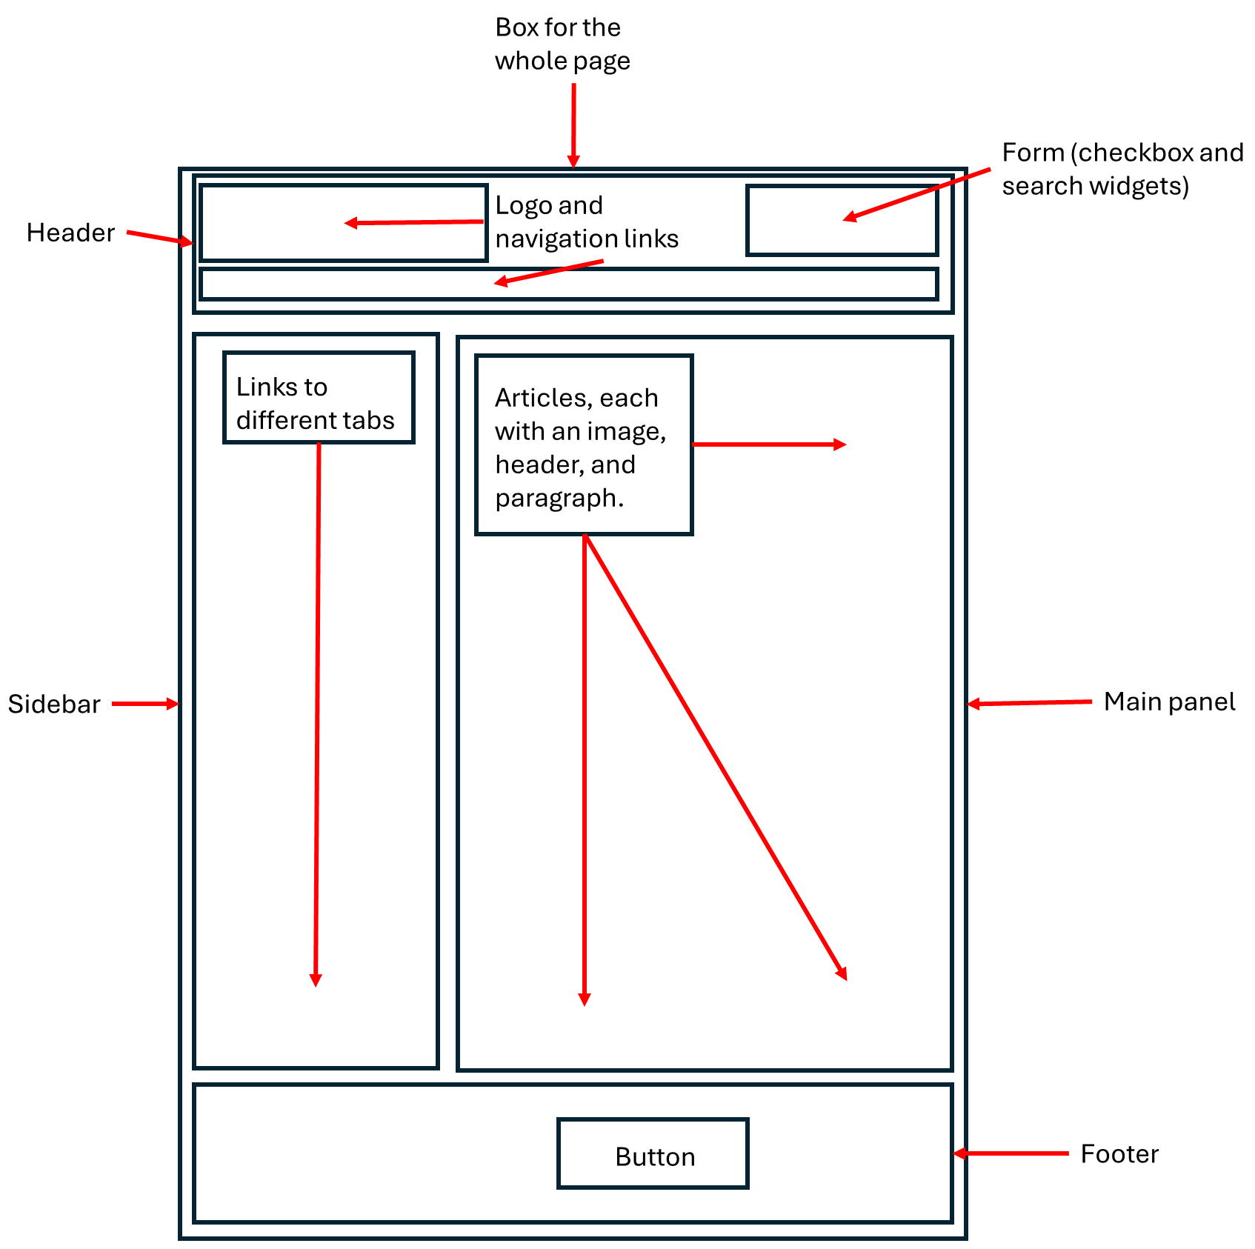
All the world’s a nested box
I want you to envision a webpage like this: As a nested set of boxes holding stuff and other boxes.
Notes:
What I want you to see, when you look at a webpage like this, is what a web developer might see: a bunch of boxes and stuff!
There’s one box holding the whole page, containing three boxes—a header, a footer, and a main area. The header has a box for a form containing widgets like a search bar, a box for a logo image, and a box for a navigation bar.
The main area box contains a sidebar box and a main panel box, with the main panel divided into article boxes each containing headers, images, and text blocks. And so on!
The point is to think about a webpage as less of “one single thing” and more of a bunch of containers stuffed inside of one another.

Slide 23
Codeword: div
Here’s the code for an HTML div (short for “division,” a generic box):
<div id = "my_box">
My box's contents
</div>
An opening tag --> <div>
A closing tag --> </div>
In between --> the box’s contents:
Here, “My box’s contents”
Inside the opening tag, set attributes using attribute = “value” format.
In Shiny, we’d code the same div using R-like syntax:
div(id = "my box",
"My box's contents“
)
Hopefully, you’re seeing that this is hardly different from writing HTML!
Notes:
Let’s take a look at what an HTML “box” looks like at a coding level.
Here’s how you’d code a division, or div for short, a super generic box type, in HTML.
Let’s break this code down. First, you’ve got an opening tag, which is the name of the element (here, div) surrounded by carrots.
Then, there’s a closing tag, which is the same but with a backslash before the element name.
These two tags tell a browser where a box “begins” and “ends.”
In between, we put the box’s contents. Here, that’s text, but it could include hundreds of things, including many other HTML boxes.
Also, inside the opening tag, we can add attributes to our box using attribute = quoted value format. Here, we gave this box an ID of “my_box.” HTML ids must be unique, so this would distinguish this box from every other box on our entire webpage. We’ll see why that matters a little later.
Now, I argued earlier that, in Shiny, when we’re coding our UI using R Shiny’s UI code, we’re basically just writing HTML code with an R flair.
To prove my point, here’s how you’d code the exact same box using R Shiny code.
Ok, so, yeah, it’s R syntax—this looks like a typical R function call with typical input structure. But, hopefully, you see that this is not much different from the HTML it’s replacing!

Slide 24
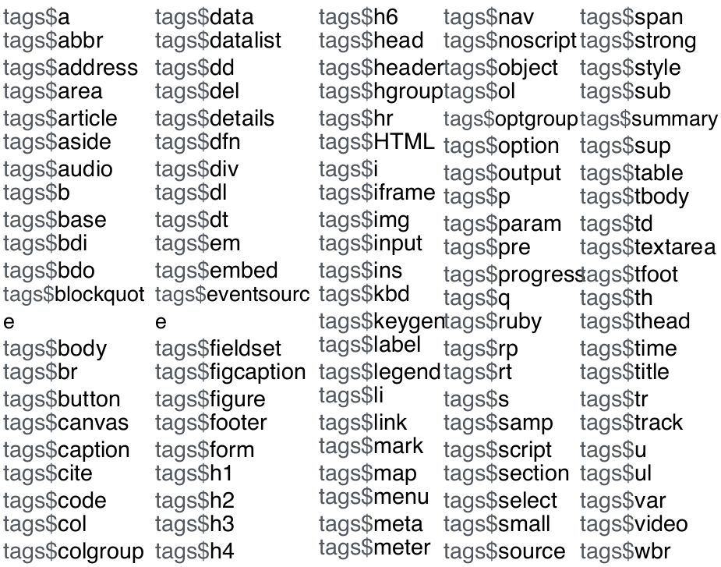
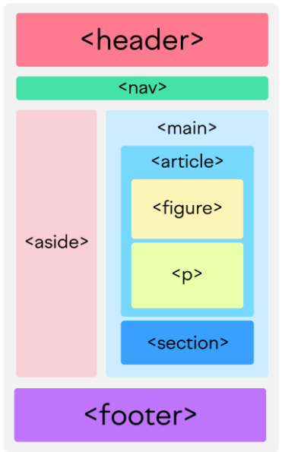
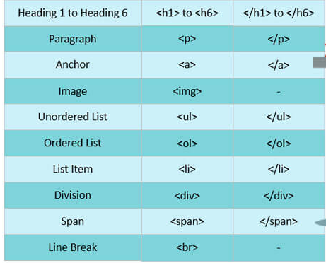
You get a box, and you get a box, and…
Notes:
divs are common boxes web devs use, but they’re by no means the only kinds! There are thousands of HTML boxes out there, although a couple dozen are used far more common than the others.
If you’re familiar with R Markdown, some of these may be familiar: You have boxes for headings (h1, h2, etc.), text boxes (called paragraphs, or ps), anchors (what we would call “links”, or as), boxes for holding images (img) numbered and bulleted lists (ol and ul), and so on. There are also more “descriptive” boxes for things like headers and footers, sidebars, navigation bars, sections of a page, figures, and so on.
Here are just some of the HTML element types you can add to your R Shiny apps using Shiny’s tags-family of functions.
So, if you can add it to a website in Wix or Squarespace, or to a report in R Markdown, or maybe even to a document in Word, you can probably build it in Shiny!

Slide 25
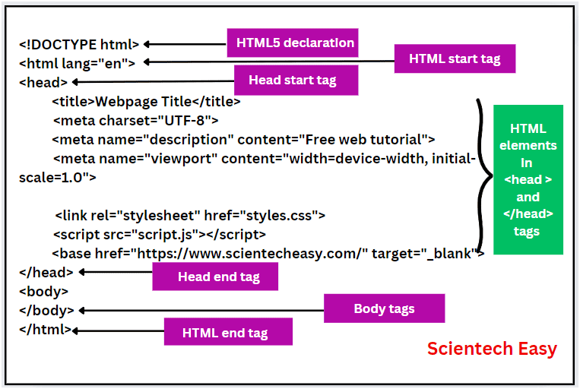
The head and the heart
Every webpage has an <html> box containing two boxes: the head and the body.
With one exception (the <title>), everything the user sees goes in the body. Shiny assumes all UI code should go there unless otherwise specified.
An exception: Linking to a CSS file:
tags$head(
tags$link(
href = "styles.css",
rel = "stylesheet“
) )
Notes:
Next, I mentioned that every website’s UI is a box (called an HTML box) and that that outermost box contains two boxes—a head and a body.
In Shiny, the HTML box is created for us invisibly—we can’t see it, touch it, or make it. And that’s fine cuz we don’t want or need to!
The head and body boxes are also created invisibly. Everything we put inside the ui object will automatically get put into the body unless we explicitly tell it not to.
So, 98%+ of our UI code, and 98%+ of what our users see, will be body box code.
However, there are two exceptions worth mentioning.
First, the head box can contain a box called “title”. It’s optional but kinda fun! Let’s see what it does—(Show them in R)
Second, I mentioned earlier that the head box is for special instructions browsers should use when building our app. That includes references to other files the browser should use when building our app, such as our CSS style sheet. Let’s reference that file in our own app by putting it in the head box manually—(Show them in R).
Adding that CSS file doesn’t do anything yet zuz that file is empty! But it won’t be for long…
Oh! And you’d link any JS files you’ve got in a similar manner, using a “script” box instead of a “link” box to do it.

Slide 26
CSS and web design 101
Notes:
The addition of our stylesheet is actually a nice segue to the last section on this unit—here, we’ll start adding real structure to our app in a way that looks nice on a range of devices.

Slide 27
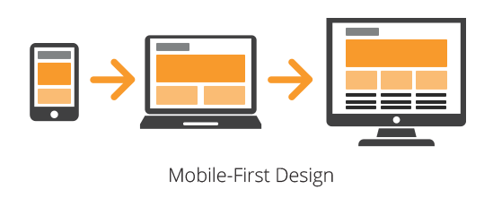
The 21st Century Challenge
One challenge of 21st Century web design: Users have a wide range of devices.
From smart watches to projector screens!
Several different browsers and OSs!
Must guide the selection of elements and also the “flow” of these elements on narrow vs. wide screens.
One paradigm: Mobile-first design (MFD).
Order all elements logically and stack them vertically, giving each max screen width.
Behind the scenes, arrange some into a grid/table or “paneled” layout, which will automatically shift to side-by-side presentation if the screen width allows.
Notes:
In fact, that charge of making a website that looks good on a range of devices is what I think of as the major challenge for 21st Century web developers.
Consider that your users might access your app on a wide variety of devices. Not just different operating systems, but also devices of vastly different sizes. From a smart watch or flip phone to a projector screen or jumbotron. If it’s on the web, any web-enabled device could try to view it!
When we’re designing a webpage, we need to consider not just what elements to include but how these should display, or “flow,” on screens of various sizes.
One paradigm I like for this is called mobile-first design. In MFD, you design your website such that, on a narrow screen, everything arranges into a single vertical column, like this.
However, you set up the UI to be flexible such that some elements might panel or grid up next to each other if the screen width allows, allowing more things to be on screen at once when that’s possible and looks nice.
This is how we’re going to design our app today, and Shiny’s tools make that easy!

Slide 28
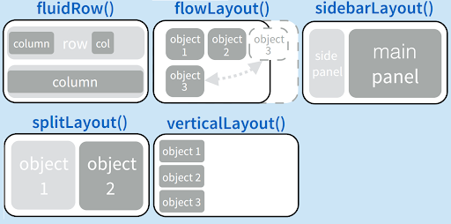
Shiny goes with the flow
Shiny’s custom HTML boxes include fluid*() functions like fluidPage() and fluidRow() .
These expand/contract to fit their contents.
They divide your page into “tables” of rows and columns such that elements that normally stack vertically instead slot side by side if there’s room.
Shiny’s custom HTML boxes also include *Layout() functions like splitLayout().
These force certain layouts regardless of the screen size, but shrink or expand regions according to their contents and the available screen width.
Notes:
It does this by providing some special HTML containers, including those in the fluid*() and *Layout() series.
For example, today, we’ll put our app’s UI inside a fluidPage container. This container will automatically expand or contract in side according to the objects we place inside it.
We can then subdivide that page box into rows, using fluidRow(), and cells using column(). This creates a “grid-like” tabular structure, in which elements that would normally choose to stack vertically by default will instead sit side-by-side if there’s room, and in which elements that would normally choose to sit side-by-side will instead stack vertically if there isn’t room. Both halves of the MFD paradigm!
We won’t use them today, but Shiny also has the converse—containers that will force a certain layout, no matter the screen side.
For example, we’re going to create something that looks like a sidebarLayout, with a smaller side panel and a wider main panel. We want this two column structure to go away on narrow screens but, if we didn’t, we could use sidebarLayout instead.

Slide 29
Jump-starting our UI!
Let’s add some basic structure to our app:
A header using h1()
One fluidRow() divided into two cells via column()s:
A side panel (1/3rd of screen width) and a main panel (2/3rds of screen width) for a “sidebar layout” on wide screens.
On narrow screens, the side panel will shift to coming first, then the main panel will come below it. Automatic mobile-first design!
A footer().
Notes:
So, let’s *finally* start doing some Shiny coding! Let’s add some basic structure to our app’s UI.
We’ll first make a header-like thing, with a title for our app, using the top-level heading function, h1.
We’ll then add a single fluidRow, which we’ll divide into two cells using column(). We’ll the columns’ width parameters to 4 and 8, respectively. That’ll make the cells take up 1/3 and 2/3rds of the screen width, respectively, something akin to a side panel and a main panel in a sidebar layout. That’s what the app will look like on a wide screen.
On narrow screens, because we add the side panel cell “first,” the side panel box will instead sit above the main panel cell, so users will encounter it first. Since it’ll contain options for messing with the main panel content, this order makes sense to me, but you might prefer a different one!
Lastly, we’ll also add a footer using the footer() container.
(Go do all this in R, and then start the app to show them—remind them at this point to switch to “launch external”!!!)

Slide 30
Why CSS?
…The app looks dull, doesn’t it?
Shiny’s default CSS is very bland/basic!
If we want our app to be pretty, we must add some CSS code.
CSS is also not a scripting language. All it does is tell a browser how to display each UI element.
Color, font, border, size, animation, alignment, etc.
Notes:
We just saw that our app is looking quite dull! And not just because there’s not much in it. I said earlier that the default CSS Shiny applies is SUPER basic.
If you want your app to be pretty, learning to add some CSS code is essential.
The good news is that CSS is also not a scripting language! All it does is tell a browser how to display each element—what colors, fonts, borders, sizes, animations, alignments, etc. to use.
In that way, it’s more akin to…I dunno…theme and the scale functions in ggplot2 than to R. What are we changing, and what are we changing it to? That’s it.
So, you CAN definitely learn enough CSS quickly to make a BIG difference, I promise!

Slide 31
The Rules of CSS
CSS’s commands are called rules. Rules have two parts:
Selector
This targets (or selects) one or more elements for styling.
Declaration block (inside of braces { })
This contains one or more properties to change paired with new values to set for those properties using property: value; format.
Notes:
So here are the absolute basics every Shiny developer should know.
CSS commands are called rules, and they have two parts. The first is called a selector because it selects the element(s) we want to style.
The second is the declaration block, or block for short, and it’s placed within braces {}.
Inside the block is a set of property and value pairs—the properties are the characteristics we want to change, and the values are what we want to set those properties to.
And this part follows a specific format—property name, colon, value, semi-colon.

Slide 32
Example CSS rule:
Note CSS’s punctuation!
h1 {
color: darkblue;
font-size: 24px;
text-align: center;
margin-top: 20px;
font-family: Arial;
}
Many CSS values take units.
CSS property names follow kebab-case.
Text values aren’t quoted.
Notes:
This’ll all be clearer with an example. Here, our selector is “h1”—this means we are targeting ALL h1 headings in our entire app, all at once, with this selector.
Then, we start our rule’s block using braces. Inside, we have 5 properties listed on the left, and five new values for those properties on the right.
Specifically, we’re setting the font color to darkblue, the font size to 24 pixels tall, vertically centering the text, adding an empty buffer of 20px to the top, and making the text Arial.
For CSS beginners, the number one thing to pay attention to is the punctuation. CSS is fussy about punctuation and, if you mess it up, you won’t get the desired effect.
Also, notice that CSS properties follow kebab-case…hyphens “skewer” all the words together :).
Lastly, note that CSS tends not to quote text-based values like many other languages do.

Slide 33
A bit more on selectors…
To target all elements of a given type, use only the element name:
h1 {…}
To target a specific element, give it an id, then use that id + a #:
#my_title {...}
To target a group of elements, give them a shared class, then use that class + a .:
.all_titles {...}
To target more than one target in the same selector, separate them with commas:
#my_title, .all_titles {...}
Selectors can get more complicated (e.g., you can target all divs directly inside of p boxes by doing p > div {…}), but knowing just these four variations will get you very far!
Notes:
A lot of learning CSS is learning the names of the properties and the names of the values to set for them. W3 school is a great resource for that, as is ChatGPT, or your devtools, which I’ll show you later.
However, it’s also important to be able to write selectors that correctly target elements. You can get far by recognizing four types of selectors.
First, as we just saw, you can target all elements of a given type by using that element’s name, such as h1 or p or div or whatever, and that’s it.
If instead you want to target just a single, specific element, you can use that element’s id attribute and a #, such as #my_title. That’s partly why we gave our containers ids earlier—to make them easier to style.
Those are the two extremes, but sometimes you want an in between: to target several elements as a group, including maybe a mix of element types. In that case, give all those elements a class attribute they share and use that class plus a dot, like .all_titles
Lastly, know that you can put multiple targets in the same selector if you separate them with commas, as shown here.
Now, of course, CSS rules can get more complicated! For example, there’s ways of targeting elements by the elements they are inside of, but you can learn more about those special cases later.

Slide 34
A little vanilla
Our title is drab—let’s jazz it up by making it bold and green.
Here’s what we’ll add to our styles.css:
#header {
color: green;
font-weight: bold;
}
Notes:
Turning back to our app, we can start to address its blandness by applying the CSS concepts we just learned to spruce up our title. Let’s make it green and bold.
To do that, we’ll add the following CSS rule to our styles.css file (go to RStudio to do this—run it and see!)
(Give them the option to adjust one other feature, if they want, to show them how to find the property name and value).

Slide 35
Tools of the trade
“What selector should I use? Why isn’t my CSS working? How could I “tinker” with my app’s design?”
First: Make sure your browser is not using old saved CSS by doing a hard refresh—control+F5 on PCs!
All these questions and more can be answered using your browser’s developer’s tools.
Notes:
Now, at this point, you might be thinking…but how do I know what selector to use, if it’s not obvious? Or what happens if my CSS doesn’t work? Or is there a way to tinker with my app’s design to see what CSS I might want?
First off, if your CSS isn’t working, it might be because your browser has stored, or cached, old CSS and is using that instead of new stuff. To fix that, do a hard refresh using control+f5 on PCs. That sometimes helps!
Otherwise, all these questions can be explored by using your browser’s developer’s tools menu.
Open this is different on every browser. On Edge, you right click and hit “Inspect.”
What you get is an intimidating screen! But really useful. On the left is all the HTML Shiny has created behind the scenes for our app. On the right is all the CSS for the element we’re looking at, including some CSS Shiny puts in by default.
You can use the developers tools to see how your HTML elements are nested and what attributes they have.
You can also see which CSS properties are being adjusted for each element. You can also see why some properties or rules aren’t maybe working as intended.
For example, crossed-out properties aren’t active; when two rules conflict, one wins and the other gets crossed out to show that. Orange properties are those with invalid values or properties, such as when we make a typo.
You can check or uncheck properties to see the difference, or enter new properties to “demo” them! It’s a great way to tinker and explore! You can do this on EVERY website you visit—they’re being built special for you on your OWN computer, after all!
Also, you can right-click any element, hit copy, and then “copy selector” to add into your clipboard the selector to use for any element you want to target!
Hopefully you can see why the developer’s tools is one of the most essential tools in every web dev’s arsenal!

Slide 36
Hour 2: R Shiny Essentials
What we’ll cover:
Adding a complex visual element (a table)
Adding an input widget (a drop-down menu)
Events and event handling
Giving users more control over events (a “go” button)
Giving ourselves more control over events (observers)
Adding a set of tabs
Notes:
I know we haven’t actually done much in R yet. But, now that we have all the basics of web development down, that can change!
We’ll spend the rest of our time in R and, in this hour, that’ll include learning the essentials of R Shiny.
Such as learning how to add complex elements like tables to our app’s UI, adding input widgets like drop-down menus to give your users things to play with, and learning about events and how to handle them.
Then, we’ll give users and ourselves more control over proceedings using a button and an observer, as well as add a set of tabs to jazz up our UI.
If the concepts at the heart of this block of material click for you, you will possess a powerful toolkit that will allow you to build a wide array of apps!

Slide 37
Turning the tables
Apps are best when they let users do fun stuff.
Let’s start with a table displaying the gapminder data set.
A table is just boxes within boxes—perfect for HTML!
…But let’s make R do the tedious task of building one.
To make a complex element in Shiny to display in our UI:
Do any “heavy lifting” with regular R code on the server side.
Render the R object server-side into the equivalent HTML object.
Pass the product to the UI into a specific place by outputting it there.
Notes:
Our app is pretty boring so far, and apps are really about allowing users to do cool things. So, let’s add some cool things, starting with a table for users to view the gapminder data set with.
if you think about it, a table seems like something HTML should excel at building—it’s just a box full of other boxes, like rows, columns and cells.
And yes you can build tables in HTML! But it’d be tedious to create such a large table in HTML ourselves. Thankfully, we can get R to do that for us.
The process of having R build a complex element like a table and then display it in the UI involves three steps:
First, any heavy lifting, aka data manipulation, needed to produce the final R object must happen.
Then, we render the R object, on the server side, into its equivalent HTML object.
Lastly, we pass the rendered element to the UI by outputting it. Let’s see all that in action: (Go to R to show them).

Slide 38





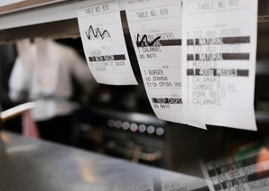

Restaurant Shiny
Rendered HTML object = Cooked meal
R code inside render*({}) = Recipe
Final R object = Uncooked meal
render*({}) = Chef
output = Waiter
outputId = Order ticket
*Output() = Table
Notes:
The code we just looked at had a lot going on! But rendering and outputting are core ideas of working in Shiny, so let’s see if we can solidify our understanding with an analogy.
I want you to think of an app as a restaurant. In this analogy, the R code we put inside our render function’s braces is the recipe—how do we build the R object we want?
The final R object itself, then, would be the assembled meal. But it isn’t ready for customers yet—it’s not “cooked.”
We need the chef, the render function, to cook it into the final meal.
Then, the waiter comes along—that’s output. It’s what will carry that cooked meal out to the users.
Our Output*() call is the table it needs to bring it to, but which table is that? Well, the outputId is like the order ticket—it tells us which food goes with which table.
Does this make sense?

Slide 39
Your input is requested
Our table looks drab, but, more importantly, it’s static—users can’t do anything with it except look at it.
Let’s allow users to interact with it—let’s add a drop-down-menu-style input widget.
This’ll allow users to decide which column the table is sorted by.
To set up an input widget in Shiny:
Place the widget in the UI using the appropriate Shiny function.
Pass the widget’s current value from the UI to the server using the input object.
Use that value inside a reactive context on the server side somehow.
Notes:
So, our table is present and functional, if a little unexciting…we’ll fix that later. In the meantime, we can address its other shortcoming—it’s not interactive! We can’t actually do anything with it but look at it.
Let’s give our users a way to interact with the table—by controlling how it’s sorted—by adding an input widget.
A widget is any UI element that users know they can fiddle with and the app will track and respond to those actions.
In this case, we’ll build a drop-down menu style widget. To set up an input widget in Shiny, we must do three things.
First, use the appropriate function to place the widget in the UI.
Second, we use the input object to pass the widget’s current value over to the server, where we can watch that value for changes.
Lastly, we use that current value in our server code somehow. Specifically, we have to use it inside of a reactive context…more on what that is in a moment.
(Go to R to start doing this, just step 1 and run).

Slide 40
Selector Connector
Our selectInput() got three inputs:
An inputId. A nickname used to slap this widget’s current value onto the input object using the $ operator and pass it to the server.
VERY like how outputIds are used to slap rendered outputs onto the output object to pass them to the UI ☺.
A label, a text go-with that’ll generally describe what the widget does.
choices. These populate the drop-down menu.
Notice that our widget doesn’t actually do anything when played with…we need to add the corresponding server code!
Notes:
We saw, as we built our selectInput, that we had to give it three inputs.
The first was an inputId. Earlier, we met output. It passes rendered outputs from the server to the UI via outputIds.
Now, we’ll soon meet input, which does exactly the opposite--it passes to the server the current value of any input widgets, which it does using inputIds.
We also gave the widget a label, which is text that accompanies the widget and, usually, describes what it does to the user.
Lastly, we gave this widget choices, which will be the options in the drop-down menu.
All other Shiny input widgets, of which there are many, are very similar to selectInput, so it’s a good first example.
Now, you’ll notice that our widget doesn’t actually do anything yet—to fix that, we need to keep going and add the appropriate server code to “wire up” this widget.
(Go do this, and demonstrate to them that it works).

Slide 41
Event planning
Time for some terminology!!!
Event: Any action a user can take the app might track.
Ex: User selects a new choice for our widget.
Event handling: Executing code that “decides” how (if) the app will react.
Ex: Our app re-sorts the table.
Reactive object: A value that might change at any time as a result of an event (rather than due to our own code).
Ex: input$sorted_column, which will change in value whenever the user selects a new choice.
Reactive context: A code block Shiny knows might contain reactive objects.
Ex: renderTable’s expression (the braced part { … })
In general, braces ( { … } ) mark reactive contexts in R Shiny server functions.
Key idea: Whenever a reactive object inside a reactive context changes, Shiny “handles” that by re-running the entire reactive context.
The logic: If key inputs have changed, our outputs are “outdated” and need refreshing.
Notes:
Ok, we’re finally to the most critical concept in all of R Shiny/web development! So, it’s time to pause for some key terminology.
First, web devs talk of events. An event is any action a user takes that the app *might* be tracking or watching for. In this example, an event would be a user selecting a new choice in our widget.
We also talk about handling events, which is having code run that determines the app’s reaction. In our case, our app’s reaction would be to resort the table.
That brings us to the concept of reactivity. A reactive object is any object whose value might change as a result of an event—the user triggers the change, not us.
An example is input$sorted_column. Its value changes every time the user selects a new choice.
A reactive context, then, is a code block that might contain reactive objects like input$sorted_column and, thus, Shiny needs to be watching inside it for events.
In our case, renderTable’s expression, the part inside the braces, is a reactive context, so it can contain values like input$sorted_column and R will watch it for events.
In general, if an R Shiny server function takes as an input an expression in braces, it’s probably a reactive context, although we will see one notable exception a bit later.
Here’s the key idea: Whenever a reactive object, like input$sorted_column changes inside of a reactive context, Shiny handles that event by rerunning the entire reactive context.
The logic here actually makes sense. If a reactive context produces an output, like a table, and key inputs to that process have changed, maybe our outputs are “outdated” and need refreshing, and the way to do that is to rerun the code that makes them. Make sense?
(Demonstrate this fact using print(). Tell them this is also a great way to troubleshoot—when is code running? What are the values of things?)
(Also demonstrate that we cannot put reactive objects somewhere other than inside a reactive context.

Slide 42
Advance directive
In R, YOU’RE the user. R must meet YOUR needs NOW.
Imperative evaluation: “R, make me a sandwich, in this order, ASAP!”
For a Shiny app, though, you’re not the user! Your users are whoever, with whatever needs, whenever.
We must anticipate their needs and plan for them!
Directive evaluation: “R, whenever someone comes and wants a sandwich, use these general instructions to make it using whatever inputs are relevant. Oh, and don’t do stuff unless and until needed.”
Notes:
I said earlier that R Shiny server code might feel unfamiliar. I hope you’re seeing what I meant!
The reason for this is that our relationship with R is very different when we’re writing R code vs R Shiny server code.
In R, we’re the user. We have needs, and we want R to meet those needs NOW.
R evaluates code imperatively for that reason. It runs code from top to bottom, as fast as it can, as soon as we ask it to. It’s the evaluation equivalent of us yelling, R, make me a sandwich this exact way, pronto! and it responding yes sir/maam!
But, when you’re writing server code, you have to realize: you’re NOT the user anymore! Your needs are irrelevant. The users are whoever visits your app. More crazily, their needs could be whatever, and they could want them whenever, in whatever order.
So, our job here is as the programmers who anticipate these needs and plan for them.
In line with this, R Shiny server code evaluates directively instead. It waits until an event occurs and re-runs whichever reactive contexts are affected and only those contexts. It’s the equivalent of saying (read what’s on the slide).
Does this distinction make sense?

Slide 43
Button chops
Users may want more control over when the table updates, especially if they have lots of widgets to adjust.
Let’s give them a button widget—the table won’t update until it’s pressed.
How should we handle button presses?
We want button presses to trigger rebuilds, but new selections in our drop-down menu should not.
But we still want to use the current menu selection to influence how the table rebuilds, when it does.
This is a good time to use isolation.
isolate() allows use of a reactive object’s value but prevents event triggering.
Notes:
Now, you’ll notice that the way we’re handling our drop-down menu widget causes the table to rebuild every time a new choice is made.
This approach is ok because we only have one widget and rebuilding this table is really fast.
But if we had lots of widgets, or if rebuilding the table was slow, a user might want more say in when the table rebuilds so that, e.g., they could dial in all their selections before triggering the rebuild.
Let’s add a button widget to give them that power.
(Go off to R to do it).
We have our button, but we still need to handle its events. We want button presses to trigger a table rebuild, so let’s add input$go_button to our renderTable({})’s reactive context to get R to start watching it for events in the way we want (do that in R).
However, input$sorted_column is still in here too, so changing the menu will also still trigger a rebuild. And we can’t remove input$sorted_column because, if we did, we couldn’t use its value to influence how to sort the table. Are we stuck?
No. This is a time to use isolation. The isolate function allows us to access a reactive object’s value for use in operations but prevents changes to that object from being considered an event. (Show them)

Slide 44
Observe and report
Isolation works well in simple situations.
When there are many reactive objects needing isolation, though, it gets clunky!
If we want to code a “if [this], then [that]” response, it’s cleaner to use observeEvent({},{}).
Notes:
This situation is pretty simple—we have just two inputs, and we only needed to “silence” one with isolate to get the outcome we wanted.
If you have a much more complex situation, like one that would require a ton of isolating, there’s a cleaner option: observeEvent.
observeEvent allows us to code up a “if exactly this happens, do exactly that” response to events.
(Go off and show them).

Slide 45
Observe and report II
Note that the app works the same as before; the two approaches are equivalent.
However, observeEvent({},{}) is more precise:
“Hey R, if {first expression} changes, do {second expression}. Never execute the first expression, and never trigger events within the second expression.”
It’s like expression 1 is on “mute,” and expression 2 is isolate()d!
Notes:
Notice that, with those changes, the app works exactly the same as before! These two approaches work the same.
However, the second is much more precise. It tells R, hey, listen for changes in this first expression and, when one happens, trigger the second expression.
Oh, and also, never execute the first expression, and never trigger events within the second expression.
It’s like the 1st expression is on “mute”—it can’t do work or make outputs, it can only trigger events.
Meanwhile, the 2nd expression is functionally isolated—it can only do work and make outputs and NOT trigger events.
So, we can watch just one specific thing and use as many reactive objects in the response as we want without needing isolate once. Hopefully, you can see how this would be useful!

Slide 46
Tabby cats
In the last hour, we’ll make an upgraded table and add a graph and map.
Let’s create spaces in our UI for these using a tabsetPanel to create three tabs, one for each new element.
Note that the latter two tabs are empty, but not for long!
Notes:
At this point, we understand the core Shiny concepts of rendering and outputting, events and event handling, widgets, and reactivity, so we have all the conceptual tools we need to build incredible apps!
In the last hour, we’ll upgrade our table and add interactive maps and graphs. To keep our UI organized, though, let’s first split the main panel cell of our app into three tabs using the Shiny functions tabsetPanel() and tabPanel().
(Go off and do that, and show them).
Note that our latter two tabs are empty, but we’ll soon change that!

Slide 47
Hour 3: Adding Showstoppers
What we’ll cover:
For DT tables, leaflet maps, and plotly graphs, we’ll see…
How to add a default version to our app.
How to adjust interactive features.
How to style/customize a little.
How to update one “on the fly” using a proxy.
What events you can track and handle.
Notes:
In this final hour, my plan is to introduce you to three powerhouse packages that can turn a good Shiny app into a great one: DT, leaflet, and plotly for building interactive tables, maps, and graphs.
For each, we’ll learn how to add a basic version so you can just how many features these come with by default. We’ll also see how to turn some of those features off if we want to.
We’ll also learn a little about customization and styling these elements.
If there’s time, I also want to show you how to update these elements without rebuilding them using a web dev mechanism called a “proxy.”
And lastly, I’ll mention some of the user interactions with these elements you can track and respond to, if you want.

Slide 48
Turning the tables
Let’s start with DT, the JS (and now R) package for building interactive, web-enabled tables.
It’s most like things we’ve already seen, and it’ll allow us to swap out our current table for a cooler one.
And we can learn all the essential concepts along the way!
We just need to replace our renderTable({}) and tableOutput() calls for renderDT({}) and dataTableOutput() ones!
Notes:
Of the three packages we’ll meet in this hour, I want to start with DT for a few reasons.
It’ll allow us to swap out our current table for a cooler one, and it also features characteristics most like those we already know. But it still introduces all the key ideas we’ll need to understand plotly and leaflet too.
To get started, we just need to swap out our current render and output calls for the equivalent DT ones—that’s it!
(Go off and do that)
(Show them all the new features that DT tables come with—pagination, page length, search, sorting, and row selection).

Slide 49
Simmer down
The first theme of the hour: Interactive Shiny graphics come with a lot of interactive features!
…That isn’t always good. Users may find them overwhelming, confusing, or superfluous.
It’s best to rewind to the essentials, then add intentionally.
The second theme: With DTs (or leaflets or plotlys), if there’s a feature, it can be disabled somehow.
In DT, the way often involves the options parameter of datatable().
Notes:
As we just saw, DT tables come with lots of interactivity out of the box! This’ll be a theme; plotlys and leaflets are similar.
This isn’t always good! From a UX, or user experience, standpoint, having lots of options may be overwhelming, confusing, or unnecessary-feeling for some users.
IMO, it’s best to rewind to the essentials and then turn features on intentionally when they’re beneficial and understandable.
That’s the second theme: You can do that! If there’s a feature in these packages, there’s also a way to disable it.
In DT, that’s usually by manipulating something inside of the datatable() function.
(Go off and disable several features, then show them).

Slide 50
Style wild
The third theme: Each package comes with stylization options that largely circumvents the need for raw CSS.
In DT, we can use the format*() and style*() functions to style our table using CSS disguised as R code.
Notes:
Next, I want to show that all three packages come with lots of stylization options; you should rarely need raw CSS to style these graphics.
For example, in DT, we can use the format and style functions to adjust our table’s looks. However, as you’ll see, the system here is really not much different from writing CSS anyhow!
(Go off and show them, indicating that the examples are just meant to show you what’s possible.).

Slide 51
Newsflash
So far, to handle requested changes, we’ve rebuilt our table.
This is inefficient, “buggy-looking,” disruptive, and potentially slow.
The fourth theme: Update complex elements; don’t rebuild them!
To update a graphic, changing only what’s needed, we use a proxy.
Proxies are “direct lines” between the server and the UI for tweaking a pre-existing graphic without rebuilding it.
We’ll use dataTableProxy() to establish the “phone call” and then replaceData() to swap the data, leaving the rest unchanged.
Notes:
Moving on, let’s consider how we’ve handled events for our table so far.
Til now, if our table needed changing, we’ve simply had renderTable rebuilt it from scratch.
That works, but, if you think about it, it’s inefficient—it requires putting the “building code” in two places. It also looks to the user like a “flickering” or “locking up”, they’ll lose any progress with the old table and, if rebuilding is slow, the user has to wait.
It’d be better if, instead, we updated the table! In Shiny, we do that using something called a proxy. This is like a direct phone line btw. the server and the UI that allows the server to tweak a graphic the user can already see without commissioning a re-build.
Here, whenever the table needs re-sorting, we’ll use DT’s proxy function to establish a “phone call,” and then the function replaceData to swap out the old data for the new, touching nothing else.
(Go do that).
This solution is cleaner, faster, less disruptive, and more code-efficient!

Slide 52
Mr. Game and Watch
DT tables, plotly graphs, and leaflet maps aren’t just sweet graphics—they’re widgets in their own right.
User interactions with them can trigger events we can watch for and handle.
Data from these events are passed via the input object, as usual.
For example, if cell selection is enabled, we can get the row and column numbers of the selected cell via input$[outputId]_cells_selected.
For time, we won’t actually handle these events here, but check out the online curriculum for an example and some challenges!
Notes:
The last thing I want to show you about DT tables is that they aren’t just powerful and pretty—they’re also widgets.
That is, the app can gather data on user interactions with them and use those to trigger events, passing that event data to the server for a response via the input object.
For example, I said earlier that selection doesn’t do anything by default, but it could. If we enable selection of individual cells, we can get the row and column numbers of the selected cell via input$[our table’s outputId]_cells_selected.
(Go show them this—first, turn on cell selection, then build new observer to watch for it. Use print to show them the value of the object as it changes.)
Now, this just shows that we can access these data server-side. Events are being triggered! But we’re not really handling them yet—I won’t show you an example of doing that here today, but I do in the online curriculum. I use these clicks to procedurally generate some text to show the user, and I also show all the problems that doing so can cause! So check that out.

Slide 53
Turning over a new leaflet
leaflet is a JS (and now R) package for making web-enabled, interactive maps of spatial data (e.g., lat-long).
This means we need some spatial data!
I’ve already gotten some, but you’ll need to download it: z.umn.edu/gap_map
We’ll hit all the same “story beats” for leaflet as with DT. The specifics will change, but the concepts are the same!
Notes:
We’ll now turn to leaflet, our second graphics package. This is a JS and R package for making web-enabled, interactive maps for featuring spatial data.
This means we’ll need some spatial data to use! I’ve done the hard work of making a version of the gapminder data set with spatial data attached—you just need to download it…Here’s a Z-link to that data if you did not download it during setup.
Make sure to move the file into your R Project folder, then add it to your global.R file. (Show them).
I will assume you have a gap_map object from here on out! You’ve been warned :).
In this unit, we’ll hit all the same plot points we hit for DT, so the specifics will change, obviously, but the concepts will be the same, so you’ll get to practice what you’ve just learned!

Slide 54
Map maker
Every leaflet map is built from three key components:
A call to leaflet(), which sets things up. Global options are set here.
A call to addTiles(). A tile is the map’s background.
A call to an add*() function to insert our spatial data.
For now, let’s keep the default options and tile and use addPolygons() to draw outlines around our countries.
Users probably shouldn’t be able to pan and zoom without restrictions. Let’s set mix/max zoom levels and bounds.
Notes:
Let’s start by making a basic map in which we’ll draw colored outlines around the countries in our data set.
Every leaflet map is built from three core components.
The first is a call to leaflet(). This is like ggplot() from ggplot2—it sets stuff up and you can set global options here.
Next is addTiles(). This adds a tile, or background image, to the map. You know, the thing that shows rivers and borders and roads and stuff!
Lastly, some kind of add function adds our spatial data. Since we have polygonal data (country borders), we’ll use addPolygons.
(Go do that, and show them to pan and zoom).
We just saw that both panning and zooming, when overused, can be disorienting! You can get lost. So, the top two features of a leaflet map you’ll want to adjust is these—let’s set min and max zoom levels and also set bounds users can’t pan beyond.

Slide 55
Putting on the ritz
Our map is a little messy. Let’s make the country strokes (outlines) crisper.
This is prettier! But it doesn’t show any data yet…
Let’s show 2007 life expectancy data, mapping the values to the fill (center) colors of our polygons.
This is a two-step process:
Use a color*() function to make a palette function leaflet can use to determine which colors go with which values.
Provide that function plus the data to our map.
…And we should add a legend, right?
…Could we add even more data cleanly? Yes, via tooltips.
Notes:
Now, our map is a little messy right now. That’s because leaflet’s default strokes, or outlines, aren’t the best. However, by adjusting a few parameters, we can vastly improve that. (Go do that).
This map is prettier! But, it isn’t very useful yet—it doesn’t show any data, so all countries look the same.
Let’s change that! Let’s have the map show 2007 life expectancy data from every country, using different fill colors for different values.
This’ll be a two-step process. The first step is building a color palette function leaflet can use to link colors with values. (Go and make that).
The second step is providing that color palette function plus the data to leaflet (go do that).
This is a very neat map now, but it’s still hard to interpret because there’s no legend, right? What do the colors mean? We can add a legend using addLegend (go do that).
This map is really snazzy now, and info rich! But could it be even richer? What if our users don’t know geography and want to know which country is which, or what the exact life expectancy value was there? We can display this info using tooltips that appear when a user clicks (Go add these).

Slide 56
Update, don’t rebuild II
Right now, users can’t control the map.
Let’s add a slider input widget that allows picking the year of the data shown.
First, we add this widget to our UI’s sidebar cell.
Then, we use that widget’s reactive object server-side to handle events.
We should make our server code more “agnostic” to year too.
…Did you notice the “freeze?” Rebuilding maps to handle their events is not ideal!
Let’s switch to a proxy system by using renderLeaflet({}) to build the base map and observeEvent({},{}) and a proxy to adjust it on the fly.
Notes:
We’ve built a map, adjusted its features, and dressed it up a bit. Now, we need to give users control over it so they can do cool stuff.
Let’s give them a new slider input widget that’ll allow them to pick the year of the data shown. That’s a three step process. (Outline this)
(First, wire this up in the UI and show them).
(Then, reconfigure the server-side code to change the data set and show them).
(Then, update the legend title, and move the palette maker to global.R)
The map is now really cool right? But did you notice the freeze during every event? That’s because we’re using renderLeaflet to rebuild the map each time. Spatial data are voluminous, so this takes time.
It’d be better to use a proxy like we did we DT to update the map on the fly. So let’s use the render function to build just the starting map, and the proxy and an observer to update it.
(Show them how to do this and the result).
Now, there are ways we could make that even faster and cleaner, but to me, this seems good enough!

Slide 57
Watch and learn II
Leaflet maps are widgets too! User interactions with them can be events we can handle.
For example, we can access data on events related to polygon clicks using input$[outputId]_shape_click format.
Let’s make it so that, when a user clicks a country’s polygon, this triggers the “flyTo()” feature, which will pan and zoom our map to center on the clicked location.
Obviously, only add functionality that improve the UX!
Notes:
The last thing about leaflet maps I want to show you is that they are, just like DTs, widgets. Users can poke them, triggering events we can handle.
For example, when a user clicks a polygon, that can be an event. Let’s handle such an event by panning and zooming the map to center on the clicked location.
(Show them how to do that).
Obviously, only add such functionality if it’ll enhance the user’s experience! But hopefully this shows you what’s possible.

Slide 58
A big plotly-eap
We’ll close by looking at plotly, a JS (and now R) package for creating web-enabled, interactive graphs.
For those who know ggplot2, plotly is similar (and similarly massive!). The difference: plotly graphs are interactive!
We don’t need to know plotly (or ggplot2!) to appreciate what plotly offers thanks to ggplotly().
It disassembles a ggplot and rebuilds it (more or less) in plotly.
We’ll copy-paste a complex ggplot into our app as an interesting test case: https://z.umn.edu/Rshiny.
There are renderPlotly({}) and plotlyOutput() functions, as usual.
Notes:
We’ll wrap today’s workshop by looking at plotly, a JS package for creating web-enabled, interactive graphs.
For those who know ggplot2, plotly is similar, which means it’s similarly daunting! The difference is that plotly graphs are built for the web, so they’re interactive out of the box.
The good news is we don’t actually need to learn plotly, or even know ggplot2, to appreciate plotly’s perks. We can use the ggplotly() function to convert a pre-built ggplot into a plotly graph to check one out.
This would be less fun if we had to use a boring ggplot or else build a complex one from scratch, so let’s copy-paste the code for a ggplot straight into our app from the online lesson materials.
(Go do this with them and show it to them).
(Then, convert it to a plotly and show them that).
Before we talk about this new graph’s features, let’s first get it into our app. Predictably, there are renderPlotly and plotlyOutput functions for this (go show them that).

Slide 59
Dialing things up…and down.
plotly graphs come with tons of interactivity!
Tooltips on mouse hover.
Legend key group filtering on click/double-click.
Click and drag to zoom + double-click to unzoom.
Modebar with many additional buttons.
Dialing all this back requires engaging with layout() and config().
plotly is a JS package, and it shows! Get ready for lists inside lists! ☺
layout() also lets us adjust legend placement.
Meanwhile, style() help us customize our tooltip contents to be only exactly what we specify.
Notes:
Plotly graphs come with tons of interactive features! They have tooltips on mouse hover, clicking and double-clicking the legend keys does stuff, clicking and double-clicking and dragging the graph itself does stuff, and there’s a toolbar of buttons too!
Wow, so, we really might want to dial back some of this. Doing that requires using two of plotly’s main functions: layout(), which controls graph structure, and config(), which controls behaviors.
As we use these two functions, you’ll be able to tell that plotly is a JS package—JS LOVES lists, and so prepare for lists galore! :)
(Go off and disable zoom, disable legend click events, and remove the lasso button.)
Layout, which we just met, can also help us center our legend, like in our original ggplot graph.
You’ll also notice our tooltip text is pretty cluttery. We can customize it, but doing so requires us to use a third core plotly function, style(), which controls aesthetics. Because we’re using ggplotly() to make our graph, we must pull a little witchcraft to get our custom tooltip text into our final graph (go show them that).

Slide 60
Update, don’t rebuild III
plotly has a proxy for updating graphs rather than rebuilding them.
Let’s give users a drop-down menu widget to select a new color scheme for the graph.
This doesn’t quite work…the lines and legend keys don’t change colors appropriately!
This is fixable (with pain), but it’s all kind of ggplotly()’s fault. It’d be best to rebuild this graph in plotly at this point!
Notes:
Just as with DT and leaflet, plotly has a proxy enabling us to update a graph rather than rebuild it.
Let’s see it by giving users a drop-down menu to pick a new color scheme for the graph.
(First, go add the selector to the UI).
(Then, add the new observer to watch for it and handle it). (Make sure they see the product).
Now, you’ll notice this all doesn’t quite work…the dots change colors well, but the lines and legend keys don’t.
These are solvable issues, but not in the time we have, and it’s all kind of ggplotly’s fault. We’d have an easier time if we had built our graph from scratch in plotly instead!

Slide 61
Watch and learn III
Lastly, as we have come to expect, plotly graphs are also widgets—we can track and handle events related to them.
However, plotly uses a different (but equivalent!) event system:
We must give our graph a source, sort of like an inputId.
We must register the specific event type to track (e.g., mouse clicks)
We must use an event_data() call server-side instead of input.
Let’s make so that users get a printed message containing the exact population value of a clicked point.
Notes:
The last thing to see about plotly is that plotly graphs are widgets too.
However, as widgets, they use an unorthodox event data system—they do NOT use the input object and inputIds like all other widgets we’ve seen.
Instead, we first have to give our graph another id, called a source. This will work like an inputId for this system only.
Then, we have to register the type of event we’re watching for, such as a click. You can’t just watch for all events all the time with plotly graphs, for whatever reason.
Lastly, we have to use a function called event_data() as a reactive object server-side, like we’ve used input up until now.
It’s not a *harder* system, it’s just different…let’s see it in action by using it to print the exact population value of a clicked point.
(First, set up the textOutput in the UI).
(Then, go to the global and add the source and register_event code).
(Then, go to the server and build the new observer, and show them).
This isn’t exactly a thrilling use of this functionality, but it hopefully shows you what’s possible.

Slide 62
That’s all folks!
THANK YOU FOR ATTENDING!
PLEASE provide feedback! This content is brand-new; your feedback will improve future workshops!
What else do you want to know? What things would you like to try?
An “R Shiny Cookbook” is on the way! Please reach out if you’re interested in being a reader!

Slide 63
More resources for help
Related workshops at UMN: https://workshops.umn.edu/
LATIS: https://latisresearch.umn.edu/
Minnesota Supercomputing Institute: https://www.msi.umn.edu
Data Science Initiative: https://dsi.umn.edu/
U-Spatial: https://research.umn.edu/units/uspatial

Slide 64

R Shiny
Post-workshop survey:
https://z.umn.edu/swc-post

Slide 65
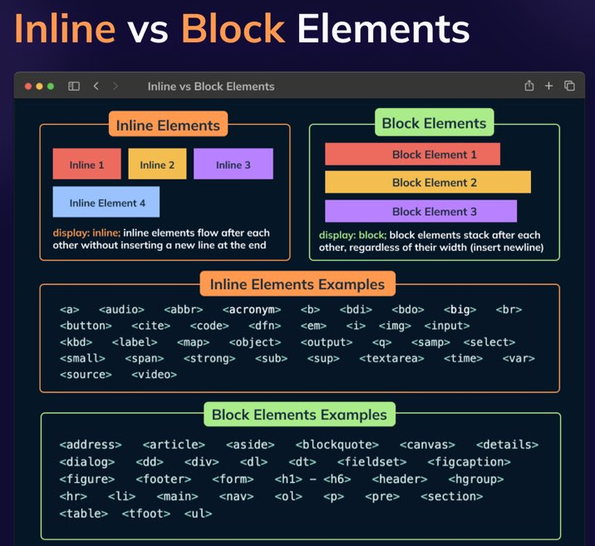
Getting blocked
All HTML elements are either inline or block. This affects what happens when they are “over.” Do we go to the next “line” or no?
Inline elements can flow after each other on the same “line.”
Blocks elements flow vertically, always forcing a new line in between them.

